Slide 1
DMS 201 : Introduction to Management Module-II: Financial Management Dr. Parvati Neelakantan

Slide 2
PART 1: BUSINESS ENVIRONMENT Lecture 4: Measuring a nation’s income

Slide 3
In this class, look for the answers to these questions:
What is Gross Domestic Product (GDP)?
How is GDP related to a nation’s total income and spending?
What are the components of GDP?
How is GDP corrected for inflation?
Does GDP measure society’s well-being?

Slide 4
Micro vs. Macro
Microeconomics: The study of how individual households and firms make decisions, interact with one another in markets.
Macroeconomics: The study of the economy as a whole.
Notes:
4

Slide 5
Income and Expenditure
Gross Domestic Product (GDP) measures total income of everyone in the economy.
GDP also measures total expenditure on the economy’s output of goods & services.
For the economy as a whole, income equals expenditure because every rupee a buyer spends is a rupee of income for the seller.
Notes:
5

Slide 6
The Circular-Flow Diagram
a simple depiction of the macroeconomy
illustrates GDP as spending, revenue, factor payments, and income
Preliminaries:
Factors of production are inputs like labor, land, capital, and natural resources.
Factor payments are payments to the factors of production (e.g., wages, rent).
Notes:
6

Slide 7
The Circular-Flow Diagram
Households:
own the factors of production, sell/rent them to firms for income
buy and consume goods & services
Firms
Households
Firms:
buy/hire factors of production, use them to produce goods and services
sell goods & services
Notes:
7

Slide 8
The Circular-Flow Diagram
Revenue (=GDP)
Spending (=GDP)
Markets for Goods & Services
G & S sold
G & S bought
Firms
Households
Factors of production
Labor, land, capital
Markets for Factors of Production
Wages, rent, profit (=GDP)
Income (=GDP)
Notes:
8

Slide 9
What This Diagram Omits
The government
collects taxes, buys goods & services
The financial system
matches savers’ supply of funds with borrowers’ demand for loans
The foreign sector
trades goods & services, financial assets, and currencies with the country’s residents
Notes:
9

Slide 10
Gross Domestic Product (GDP) Is…
…the market value of all final goods & services produced within a country in a given period of time.
Goods are valued at their market prices, so:
All goods measured in the same units (e.g., Rs in India)
Things that don’t have a market value are excluded, e.g., housework you do for yourself.
Notes:
10

Slide 11
Gross Domestic Product (GDP) Is…
…the market value of all final goods & services produced within a country in a given period of time.
Final goods: intended for the end user
Intermediate goods: used as components or ingredients in the production of other goods
GDP only includes final goods—they already embody the value of the intermediate goods used in their production.
Notes:
11

Slide 12
Gross Domestic Product (GDP) Is…
… the market value of all final goods & services produced within a country in a given period of time.
GDP includes tangible goods (like DVDs, mountain bikes, coke)
and intangible services (dry cleaning, concerts, cell phone service).
Notes:
12

Slide 13
Gross Domestic Product (GDP) Is…
…the market value of all final goods &
services produced within a country in a given period of time.
GDP includes currently produced goods, not goods produced in the past.
Notes:
13

Slide 14
Gross Domestic Product (GDP) Is…
…the market value of all final goods & services produced within a country in a given period of time.
GDP measures the value of production that occurs within a country’s borders, whether done by its own citizens or by foreigners located there.
Notes:
14

Slide 15
Gross Domestic Product (GDP) Is…
…the market value of all final goods & services produced within a country in a given period of time.
Usually a year or a quarter (3 months)
Notes:
15

Slide 16
The Components of GDP
Recall: GDP is total spending.
Four components:
Consumption (C)
Investment (I)
Government Purchases (G)
Net Exports (NX)
These components add up to GDP (denoted Y):
Y = C + I + G + NX
Notes:
16

Slide 17
Consumption (C)
is total spending by households on g&s.
Note on housing costs:
For renters, consumption includes rent payments.
For homeowners, consumption includes the imputed rental value of the house, but not the purchase price or mortgage payments.
Notes:
17

Slide 18
Investment (I)
is total spending on goods that will be used in the future to produce more goods.
includes spending on
capital equipment (e.g., machines, tools)
structures (factories, office buildings, houses)
inventories (goods produced but not yet sold)
Note: “Investment” does not mean the purchase of financial assets like stocks and bonds.
Notes:
18

Slide 19
Government Purchases (G)
is all spending on the g&s purchased by govt at the federal, state, and local levels.
G excludes transfer payments, such as Social Security or unemployment insurance benefits.
They are not purchases of g&s.
Notes:
19

Slide 20
Net Exports (NX)
NX = exports – imports
Exports represent foreign spending on the economy’s g&s.
Imports are the portions of C, I, and G that are spent on g&s produced abroad.
Adding up all the components of GDP gives:
Y = C + I + G + NX
Notes:
20

Slide 21
ACTIVE LEARNING ₁ GDP and its components
In each of the following cases, determine how much GDP and each of its components is affected (if at all).
A. Debbie spends $200 to buy her husband dinner at the finest restaurant in Boston.
B. Sarah spends $1800 on a new laptop to use in her publishing business. The laptop was built in China.
C. Jane spends $1200 on a computer to use in her editing business. She got last year’s model on sale for a great price from a local manufacturer.
D. General Motors builds $500 million worth of cars, but consumers only buy $470 million worth of them.

Slide 22
ACTIVE LEARNING ₁ Answers
A. Debbie spends $200 to buy her husband dinner at the finest restaurant in Boston.
Consumption and GDP rise by $200.
B. Sarah spends $1800 on a new laptop to use in her publishing business. The laptop was built in China.
Investment rises by $1800, net exports fall by $1800, GDP is unchanged.

Slide 23
ACTIVE LEARNING ₁ Answers
C. Jane spends $1200 on a computer to use in her editing business. She got last year’s model on sale for a great price from a local manufacturer.
Current GDP and investment do not change, because the computer was built last year.
D. General Motors builds $500 million worth of cars, but consumers only buy $470 million of them.
Consumption rises by $470 million, inventory investment rises by $30 million, and GDP rises by $500 million.

Slide 24
Real versus Nominal GDP
Inflation can distort economic variables like GDP, so we have two versions of GDP:
Nominal GDP
values output using current prices
not corrected for inflation
Real GDP
values output using the prices of a base year
is corrected for inflation
Notes:
24

Slide 25
EXAMPLE:
 | Pizza |  | Latte
year | P | Q | P | Q
2011 | Rs10 | 400 | Rs2.00 | 1000
2012 | Rs11 | 500 | Rs2.50 | 1100
2013 | Rs12 | 600 | Rs3.00 | 1200
Compute nominal GDP in each year:
2011: Rs10 x 400 + Rs 2 x 1000 = Rs6,000
2012: Rs11 x 500 + Rs2.50 x 1100 = Rs8,250
2013: Rs12 x 600 + Rs 3 x 1200 = Rs10,800
Increase:
37.5%
30.9%
Notes:
25

Slide 26
EXAMPLE:
 | Pizza |  | Latte
year | P | Q | P | Q
2011 | $10 | 400 | $2.00 | 1000
2012 | Rs11 | 500 | Rs2.50 | 1100
2013 | Rs12 | 600 | Rs3.00 | 1200
Rs10
R2.00
Compute real GDP in each year, using 2011 as the base year:
Increase:
2011: Rs10 x 400 + Rs2 x 1000 = Rs6,000
2012: Rs10 x 500 + Rs2 x 1100 = Rs7,200
2013: Rs10 x 600 + Rs2 x 1200 = Rs8,400
20.0%
16.7%
Notes:
26

Slide 27
EXAMPLE:
year | Nominal GDP |  | Real GDP
2011 | Rs6000 |  | Rs6000
2012 | Rs8250 |  | Rs7200
2013 | Rs10,800 |  | Rs8400
In each year,
nominal GDP is measured using the (then) current prices.
real GDP is measured using constant prices from the base year (2011 in this example).
Notes:
27

Slide 28
EXAMPLE:
year | Nominal GDP |  | Real GDP
2011 | Rs6000 |  | Rs6000
2012 | Rs8250 |  | Rs7200
2013 | Rs10,800 |  | Rs8400
37.5%
20.0%
30.9%
16.7%
The change in nominal GDP reflects both prices and quantities.
The change in real GDP is the amount that GDP would change if prices were constant (i.e., if zero inflation).
Hence, real GDP is corrected for inflation.
Notes:
28

Slide 29
The GDP Deflator
The GDP deflator is a measure of the overall level of prices.
Definition:
GDP deflator = 100 x
nominal GDP
real GDP
One way to measure the economy’s inflation rate is to compute the percentage increase in the GDP deflator from one year to the next.
Notes:
29

Slide 30
EXAMPLE:
year | Nominal GDP | Real GDP | GDP Deflator
2011 | Rs6000 | Rs6000
2012 | Rs8250 | Rs7200
2013 | Rs10,800 | Rs8400
100.0
14.6%
114.6
12.2%
128.6
Compute the GDP deflator in each year:
2011: 100 x (6000/6000) = 100.0
2012: 100 x (8250/7200) = 114.6
2013: 100 x (10,800/8400) = 128.6
Notes:
30

Slide 31
ACTIVE LEARNING ₁ Computing GDP
 | 2011 (base yr) |  | 2012 |  | 2013
 | P | Q | P | Q | P | Q
Good A | Rs30 | 900 | Rs31 | 1000 | Rs36 | 1050
Good B | Rs100 | 192 | Rs102 | 200 | Rs100 | 205
Use the above data to solve these problems:
A. Compute nominal GDP in 2011.
B. Compute real GDP in 2012.
C. Compute the GDP deflator in 2013.

Slide 32
ACTIVE LEARNING ₁ Answers
 | 2011 (base yr) |  | 2012 |  | 2013
 | P | Q | P | Q | P | Q
Good A | Rs30 | 900 | Rs31 | 1,000 | Rs36 | 1050
Good B | Rs100 | 192 | Rs102 | 200 | Rs100 | 205
A. Compute nominal GDP in 2011.
Rs30 x 900 + Rs100 x 192 = Rs46,200
B. Compute real GDP in 2012.
Rs30 x 1000 + Rs100 x 200 = Rs 50,000

Slide 33
ACTIVE LEARNING ₁ Answers
 | 2011 (base yr) |  | 2012 |  | 2013
 | P | Q | P | Q | P | Q
Good A | Rs30 | 900 | Rs31 | 1,000 | Rs36 | 1050
Good B | Rs100 | 192 | Rs102 | 200 | Rs100 | 205
C. Compute the GDP deflator in 2013.
Nom GDP = Rs36 x 1050 + Rs100 x 205 = Rs58,300
Real GDP = Rs30 x 1050 + Rs100 x 205 = Rs52,000
GDP deflator = 100 x (Nom GDP)/(Real GDP)
= 100 x (Rs58,300)/(Rs52,000) = 112.1

Slide 34
GDP and Economic Well-Being
Real GDP per capita is the main indicator of the average person’s standard of living.
But GDP is not a perfect measure of well-being.
Notes:
34

Slide 35
GDP Does Not Value:
the quality of the environment
leisure time
non-market activity, such as the child care a parent provides his or her child at home
an equitable distribution of income
Notes:
35

Slide 36
Then Why Do We Care About GDP?
Having a large GDP enables a country to afford better schools, a cleaner environment, health care, etc.
Many indicators of the quality of life are positively correlated with GDP. For example…
Notes:
36

Slide 37
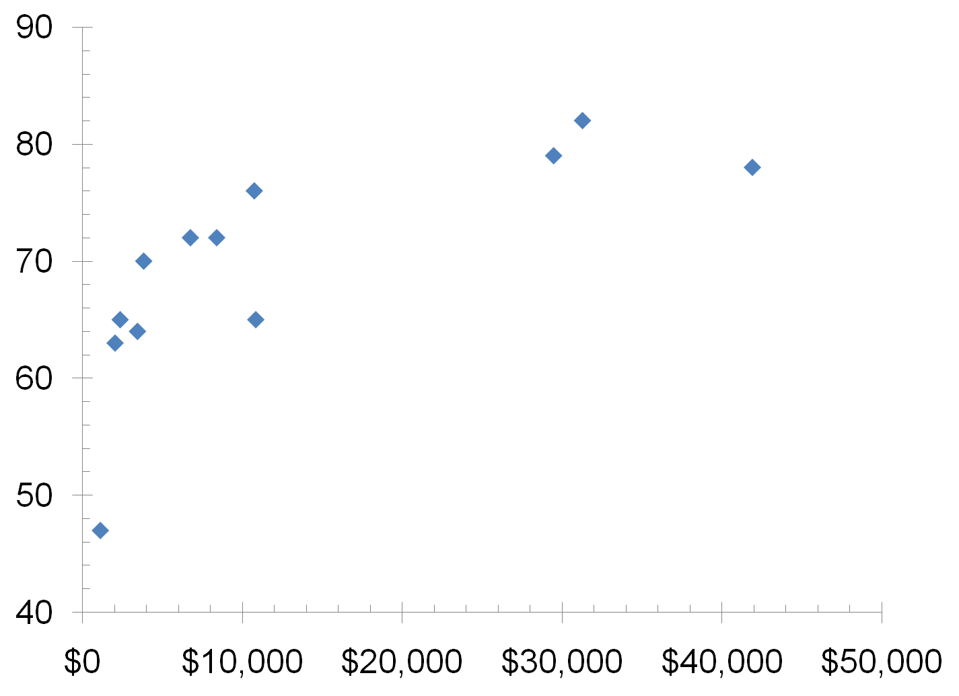
GDP and Life Expectancy in 12 countries
Indonesia
Japan
China
U.S.
Mexico
Germany
Brazil
Pakistan
Life expectancy (years)
Russia
India
Bangladesh
Nigeria
Real GDP per capita
37

Slide 38
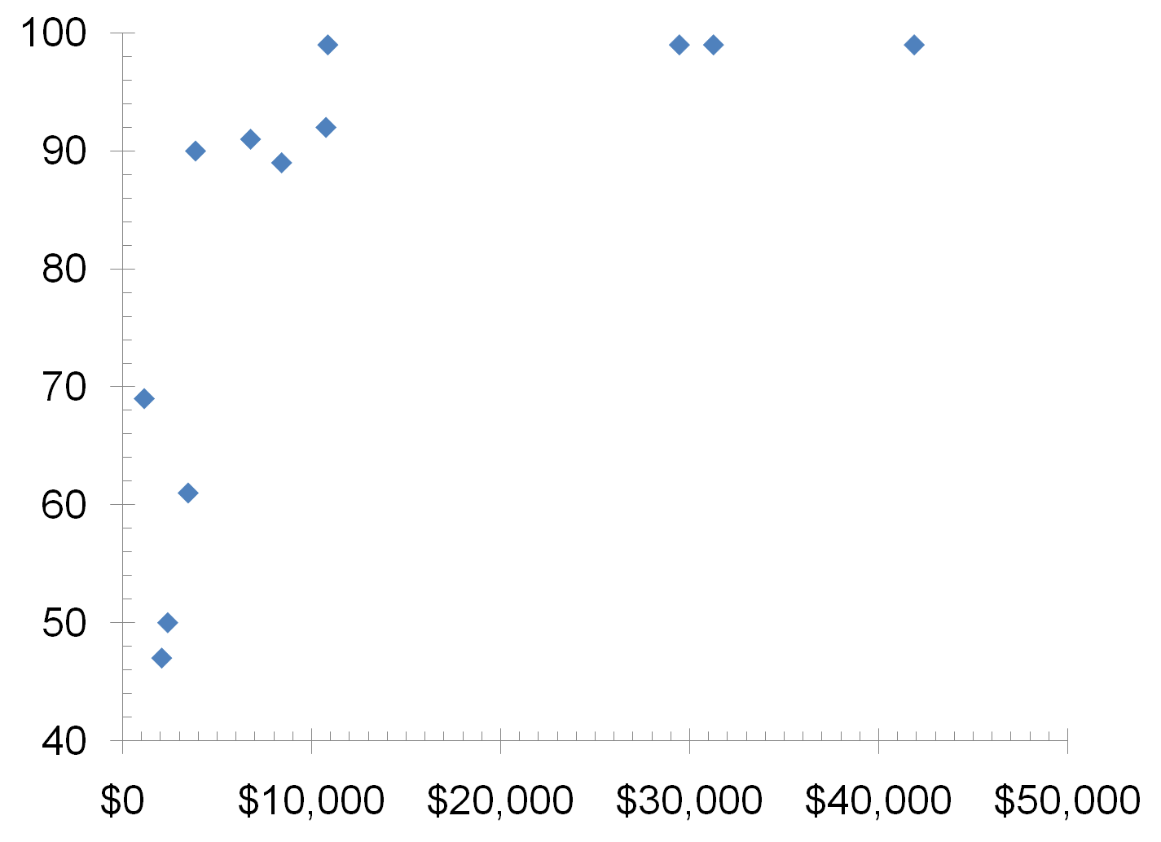
GDP and Literacy in 12 countries
China
Russia
U.S.
Germany
Japan
Mexico
Brazil
Indonesia
Adult Literacy (% of population)
Nigeria
India
Pakistan
Bangladesh
Real GDP per capita
38

Slide 39
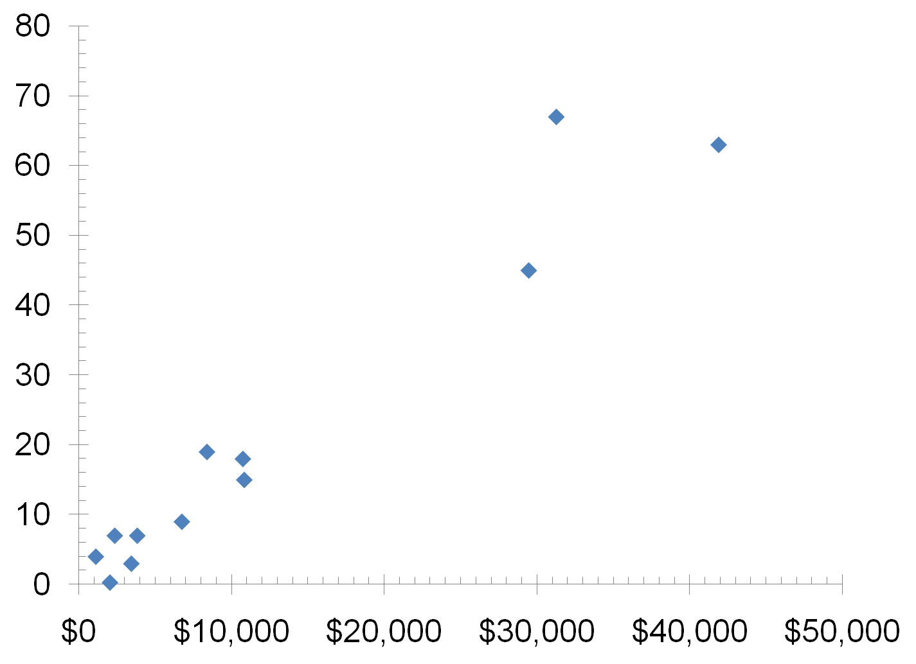
GDP and Internet Usage in 12 countries
Japan
U.S.
Germany
Internet Usage (% of population)
Brazil
Indonesia
Mexico
Pakistan
Russia
China
Nigeria
India
Real GDP per capita
Bangladesh
39

Slide 40
SUMMARY
Gross Domestic Product (GDP) measures a country’s total income and expenditure.
The four spending components of GDP include: Consumption, Investment, Government Purchases, and Net Exports.
Nominal GDP is measured using current prices. Real GDP is measured using the prices of a constant base year and is corrected for inflation.
GDP is the main indicator of a country’s economic well-being, even though it is not perfect.

